Slide 1
SCRUM –
Agile Project Management
MTM Training and Consulting Group
Tesfaye Gari
Million Debela
Muluhabt Mehari
Nov 2016

Slide 2
Agenda
  Introduction
  Agile Project Management
  What is Scrum?
  History of Scrum
  Functionality of Scrum
  Components of Scrum
    Scrum Roles
    The Process
    Scrum Artifacts
  Scaling Scrum
  Evolution of Scrum
  Scrum & XP
  Conclusion
MTM 2016
Agile Project Management - Scrum

Slide 3
Introduction
Classical methods of software development have many disadvantages:
  huge effort during the planning phase
  poor requirements conversion in a rapid changing environment
  treatment of staff as a factor of production
New methods:
Agile Software Development
MTM 2016
Agile Project Management - Scrum

Slide 4
Manifesto for Agile SD
Based on the Manifesto for Agile Software Development
  Individuals and interactions over processes and tools
  Working software over comprehensive documentation
  Customer collaboration over contract negotiation
  Responding to change over following a plan
MTM 2016
Agile Project Management - Scrum

Slide 5
Agile Project Management
Qualities:
  Minimize risk → short iterations
  Real-time communication (prefer face-to-face) → very little written documentation
  Indicated for unpredictable / rapidly changing requirements
MTM 2016
Agile Project Management - Scrum

Slide 6
Agile Methods
Agile methods:
  Scrum
  Extreme Programming
  Adaptive Software Development (ASD)
  Dynamic System Development Method (DSDM)
  …
Agile Alliance
  A non-profit organization promotes agile development
MTM 2016
Agile Project Management - Scrum

Slide 7
What is Scrum?
Definition from rugby football:
  a scrum is a way to restart the game after an interruption, where the forwards of each side come together in a tight formation and struggle to gain possession of the ball when it is tossed in among them
MTM 2016
Agile Project Management - Scrum

Slide 8
Scrum - an agile process
SCRUM is an agile, lightweight process for managing and controlling software and product development in rapidly changing environments.
  Iterative, incremental process
  Team-based approach
  developing systems/ products with rapidly changing requirements
  Controls the chaos of conflicting interest and needs
  Improve communication and maximize cooperation
  Protecting the team form disruptions and impediments
  A way to maximize productivity
MTM 2016
Agile Project Management - Scrum

Slide 9
History of Scrum
1995:
  analysis of common software development processes → not suitable for empirical, unpredictable and non-repeatable processes
  Design of a new method: Scrum by Jeff Sutherland & Ken Schwaber
  Enhancement of Scrum by Mike Beedle & combination of Scrum with Extreme Programming
1996:
  introduction of Scrum at OOPSLA conference
2001:
  publication “Agile Software Development with Scrum” by
  Ken Schwaber & Mike Beedle
Successful appliance of Scrum in over 50 companies
Founders are members in the Agile Alliance
MTM 2016
Agile Project Management - Scrum
Notes:
Successful = increase in productivity, satisfied/ happy team

Slide 10

Functionality of Scrum
MTM 2016
Agile Project Management - Scrum

Slide 11
Components of Scrum
  Scrum Roles
  The Process
  Scrum Artifacts
MTM 2016
Agile Project Management - Scrum

Slide 12
Scrum Master
Represents management to the project
Typically filled by a Project Manager or Team Leader
Responsible for enacting scrum values and practices
Main job is to remove impediments
MTM 2016
Agile Project Management - Scrum

Slide 13
The Scrum Team
Typically 5-10 people
Cross-functional (QA, Programmers, UI Designers, etc.)
Members should be full-time
Team is self-organizing
Membership can change only between sprints
MTM 2016
Agile Project Management - Scrum

Slide 14
Product Owner
Acts like one voice (in any case)
Knows what needs to be build and in what sequence this should be done
Typically a product manager
MTM 2016
Agile Project Management - Scrum

Slide 15
The Process
Sprint Planning Meeting
Sprint
Daily Scrum
Sprint Review Meeting
MTM 2016
Agile Project Management - Scrum

Slide 16
Sprint Planning Meeting
A collaborative meeting in the beginning of each Sprint between the Product Owner, the Scrum Master and the Team
Takes 8 hours and consists of 2 parts (“before lunch and after lunch”)
MTM 2016
Agile Project Management - Scrum

Slide 17
Parts of Sprint Planning Meeting
1st Part:
  Creating Product Backlog
  Determining the Sprint Goal.
  Participants: Product Owner, Scrum Master, Scrum Team
2nd Part:
  Participants: Scrum Master, Scrum Team
  Creating Sprint Backlog
MTM 2016
Agile Project Management - Scrum

Slide 18
Pre-Project/Kickoff Meeting
A special form of Sprint Planning Meeting
Meeting before the begin of the Project
MTM 2016
Agile Project Management - Scrum

Slide 19
Sprint
A month-long iteration, during which is incremented a product functionality
NO outside influence can interference with the Scrum team during the Sprint
Each Sprint begins with the Daily Scrum Meeting
MTM 2016
Agile Project Management - Scrum

Slide 20
Daily Scrum
Is a short (15 minutes long) meeting, which is held every day before the Team starts working
Participants: Scrum Master (which is the chairman), Scrum Team
“Chickens” and “Pigs”
Every Team member should answer on 3 questions
MTM 2016
Agile Project Management - Scrum

Slide 21
Questions
What did you do since the last Scrum?
What are you doing until the next Scrum?
What is stopping/impediments you getting on with the work?
MTM 2016
Agile Project Management - Scrum

Slide 22
Daily Scrum
Is NOT a problem solving session
Is NOT a way to collect information about WHO is behind the schedule
Is a meeting in which team members make commitments to each other and to the Scrum Master
Is a good way for a Scrum Master to track the progress of the Team
MTM 2016
Agile Project Management - Scrum

Slide 23
Sprint Review Meeting
Is held at the end of each Sprint
Business functionality which was created during the Sprint is demonstrated to the Product Owner
Informal, should not distract Team members of doing their work
MTM 2016
Agile Project Management - Scrum

Slide 24
Scrum Artifacts
Product Backlog
Sprint Backlog
Burn down Charts
MTM 2016
Agile Project Management - Scrum

Slide 25
Product Backlog
Requirements for a system, expressed as a prioritized list of Backlog Items
Is managed and owned by a Product Owner
Spreadsheet (typically)
Usually is created during the Sprint Planning Meeting
Can be changed and re-prioritized before each PM
MTM 2016
Agile Project Management - Scrum

Slide 26
Estimation of Product Backlog Items
Establishes team’s velocity (how much Effort a Team can handle in one Sprint)
Determining units of complexity.
  Size-category (“T-Shirt size”)
  Story points
  Work days/work hours
Methods of estimation:
  Expert Review
  Creating a Work Breakdown Structure (WBS)
MTM 2016
Agile Project Management - Scrum

Slide 27
Product Backlog
Is only a FORECAST!-> is not exact
MTM 2016
Agile Project Management - Scrum

Slide 28
Sprint Backlog
A subset of Product Backlog Items, which define the work for a Sprint
Is created ONLY by Team members
Each Item has it’s own status
Should be updated every day
MTM 2016
Agile Project Management - Scrum

Slide 29
Sprint Backlog
No more then 300 tasks in the list
If a task requires more than 16 hours, it should be broken down
Team can add or subtract items from the list. Product Owner is not allowed to do it
MTM 2016
Agile Project Management - Scrum

Slide 30
Sprint Backlog
Is a FORECAST!
Is a good warning monitor
MTM 2016
Agile Project Management - Scrum

Slide 31
Burn down Charts
Are used to represent “work done”.
Are wonderful Information Radiators
3 Types:
  Sprint Burn down Chart (progress of the Sprint)
  Release Burn down Chart (progress of release)
  Product Burn down chart (progress of the Product)
MTM 2016
Agile Project Management - Scrum

Slide 32
Information Radiator
"Two characteristics are key to a good information radiator. The first is that the information changes over time. This makes it worth a person's while to look at the display... The other characteristic is that it takes very little energy to view the display."
MTM 2016
Agile Project Management - Scrum

Slide 33
Burn down Charts
X-Axis: time (usually in days)
Y-Axis: remaining effort
MTM 2016
Agile Project Management - Scrum

Slide 34
Sprint Burn down Chart
Depicts the total Sprint Backlog hours remaining per day
Shows the estimated amount of time to release
Ideally should burn down to zero to the end of the Sprint
Actually is not a straight line
Can bump UP
MTM 2016
Agile Project Management - Scrum

Slide 35
Release Burn down Chart
Will the release be done on right time?
X-axis: sprints
Y-axis: amount of hours remaining
The estimated work remaining can also burn up
MTM 2016
Agile Project Management - Scrum

Slide 36
Alternative Release Burn down Chart
Consists of bars (one for each sprint)
Values on the Y-axis: positive AND negative
Is more informative then a simple chart
MTM 2016
Agile Project Management - Scrum

Slide 37
Product Burn down Chart
Is a “big picture” view of project’s progress (all the releases)
MTM 2016
Agile Project Management - Scrum

Slide 38
Scaling Scrum
A typical Scrum team is 6-10 people
Jeff Sutherland - up to over 800 people
"Scrum of Scrums" or what called "Meta-Scrum“
Frequency of meetings is based on the degree of coupling between packets
MTM 2016
Agile Project Management - Scrum

Slide 39
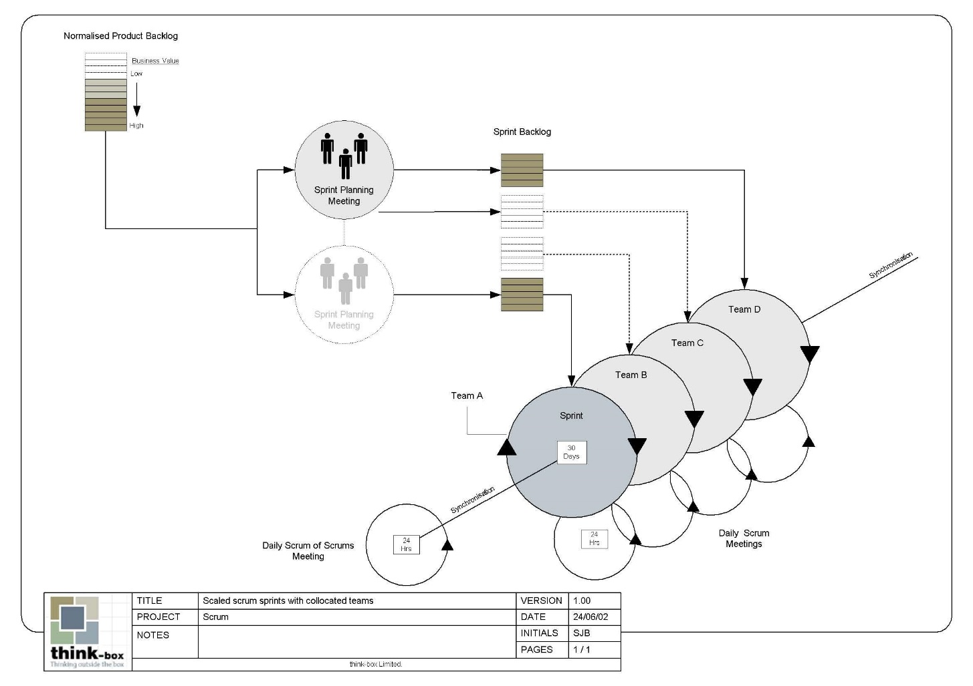
Scaling Scrum
MTM 2016
Agile Project Management - Scrum

Slide 40
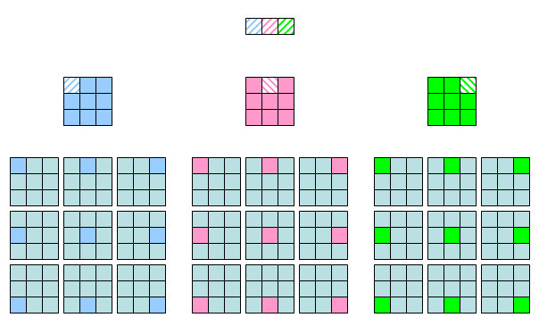
Scaling Scrum
MTM 2016
Agile Project Management - Scrum

Slide 41
XP@Scrum
Scrum is an effective project management wrapper for eXtreme Programming development practices, which enables agile projects to become scalable and developed by distributed teams of developers.
MTM 2016
Agile Project Management - Scrum

Slide 42
Pro/Con
Advantages
  Completely developed and tested features in short iterations
  Simplicity of the process
  Clearly defined rules
  Increasing productivity
  Self-organizing
  each team member carries a lot of responsibility
  Improved communication
  Combination with Extreme Programming
Drawbacks
  “Undisciplined hacking” (no written documentation)
  Violation of responsibility
  Current mainly carried by the inventors
MTM 2016
Agile Project Management - Scrum

Slide 43
Conclusion
Thanks for you attention!
Any questions?
MTM 2016
Agile Project Management - Scrum

